Slide 1


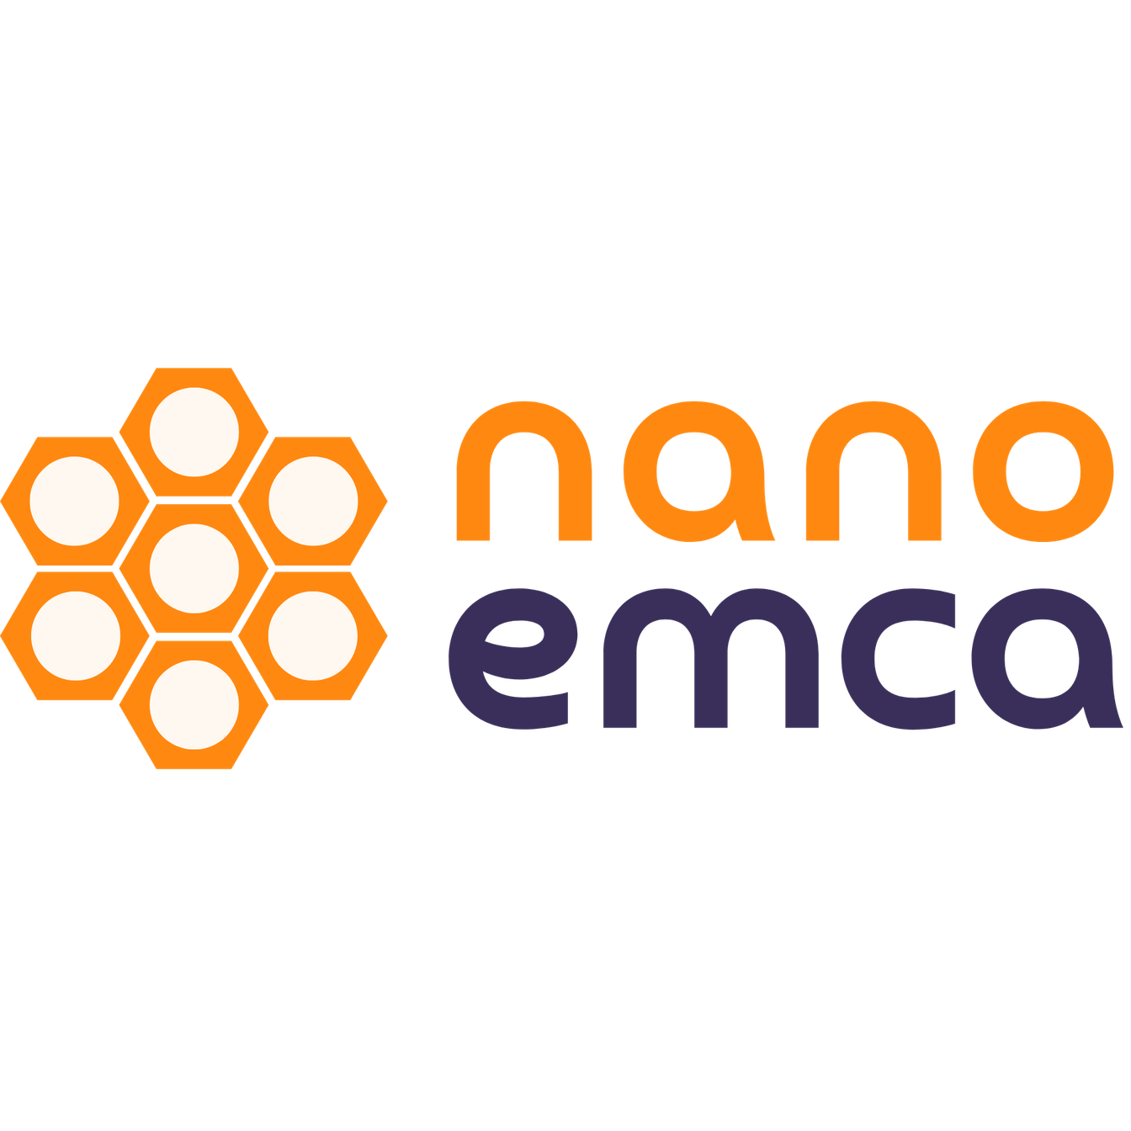
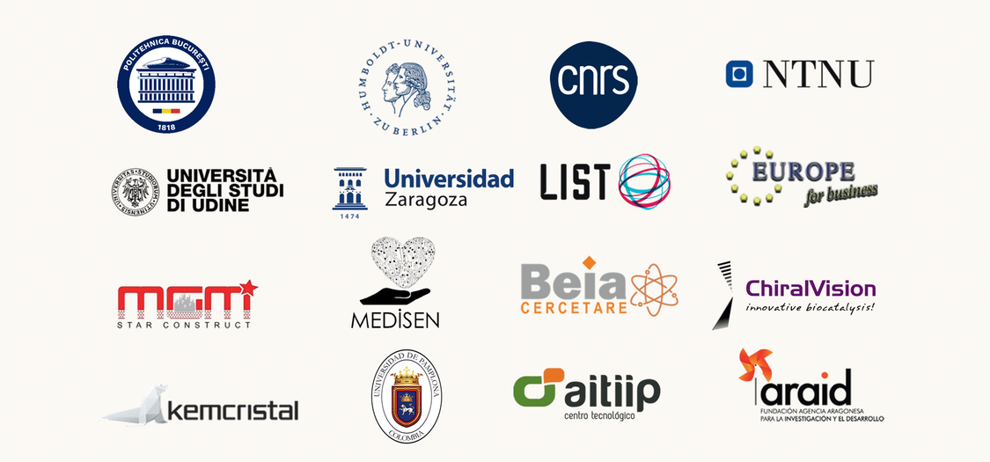

This project has received funding from the European Union’s Horizon Europe research and innovation program under the grant agreement No. 101235833.
Views and opinions expressed are those of the author(s) only and do not necessarily reflect those of the European Union or the European Research Executive Agency (REA).
Neither the European Union nor the granting authority can be held responsible for them.
Confined Nanoreactors for Environmental,
Medical & Catalytic Applications
NANOEMCA Project
Call: HORIZON-MSCA-SE-2024
GA No. 101235833

Slide 2


The problem
Identification
Water and air contamination from metals, dyes and pharmaceuticals
Food spoilage and limited shelf life for fresh products
Need for faster, cheaper, more sensitive medical and environmental sensors
NANOEMCA Project
Call: HORIZON-MSCA-SE-2024
GA No. 101235833

Slide 3
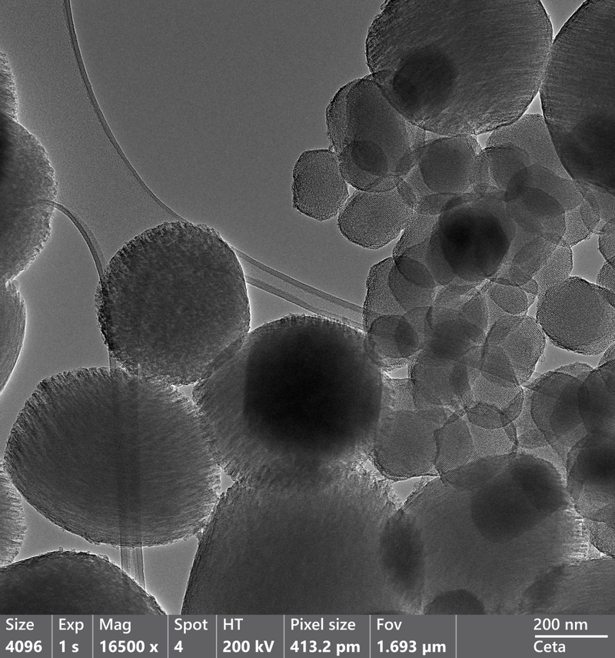
Our solution
The NANOEMCA approach
Develop a family of engineered, porous silica materials known as periodic mesoporous organosilicas (PMOs).
Highly regular, sponge-like framework whose internal walls can be custom-built with organic linkers and loaded with tiny metal species or enzymes.
NANOEMCA Project
Call: HORIZON-MSCA-SE-2024
GA No. 101235833

Slide 4
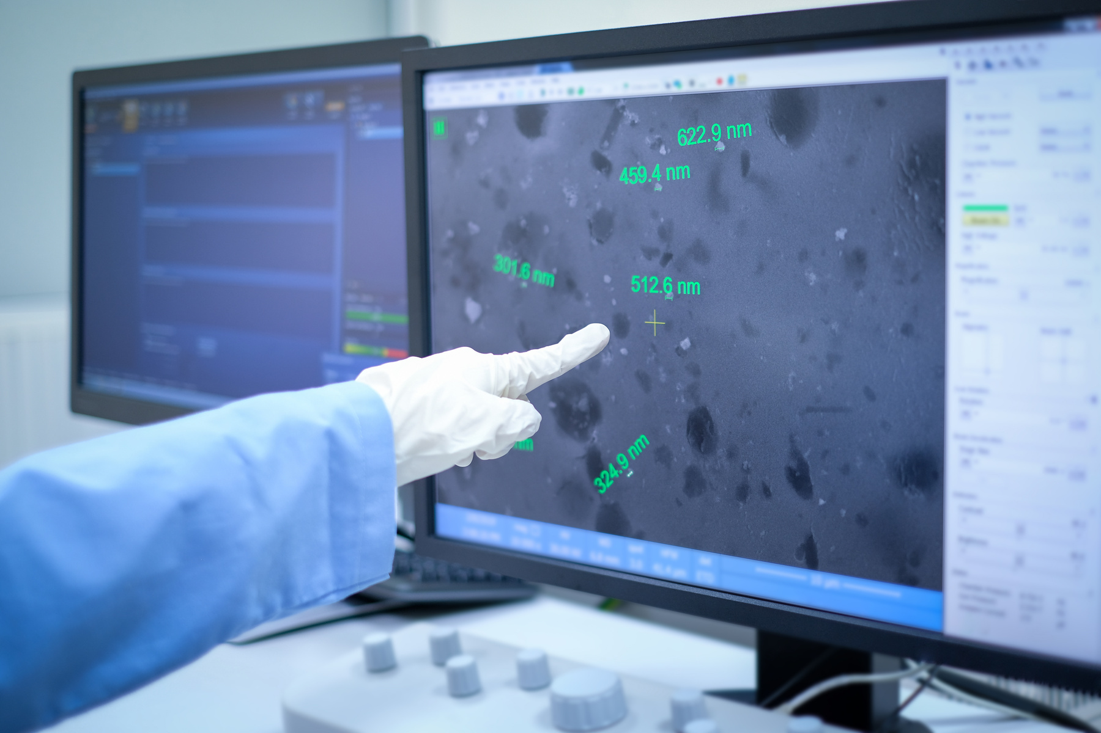
Our solution
The routes PMOs open
Water treatment: cleaner, more selective adsorbents and photocatalysts that break down persistent pollutants under low-energy light
Food sector: active packaging that slowly releases natural antimicrobials to extend shelf life
Sensing and health: sensitive electrochemical or gas sensors for environmental and clinical monitoring
NANOEMCA Project
Call: HORIZON-MSCA-SE-2024
GA No. 101235833

Slide 5

Our methodology
How do we approach it?
First, we design the building blocks that become the backbone of the porous material, which are highly controllable.
We use four complementary ways to make the materials. Every material is checked with standard tools so we know exactly what it looks like and how it behaves.
NANOEMCA Project
Call: HORIZON-MSCA-SE-2024
GA No. 101235833

Slide 6

Our methodology
Testing the nanomaterials
Real wastewater mimic for anti pollutants and water treatment
Antimicrobial timed testing for food applications
Sensitivity, response time and stability for biosensors
Life Cycle Assessment and Life Cycle Costing to compare impacts and costs between methods
NANOEMCA Project
Call: HORIZON-MSCA-SE-2024
GA No. 101235833

Slide 7
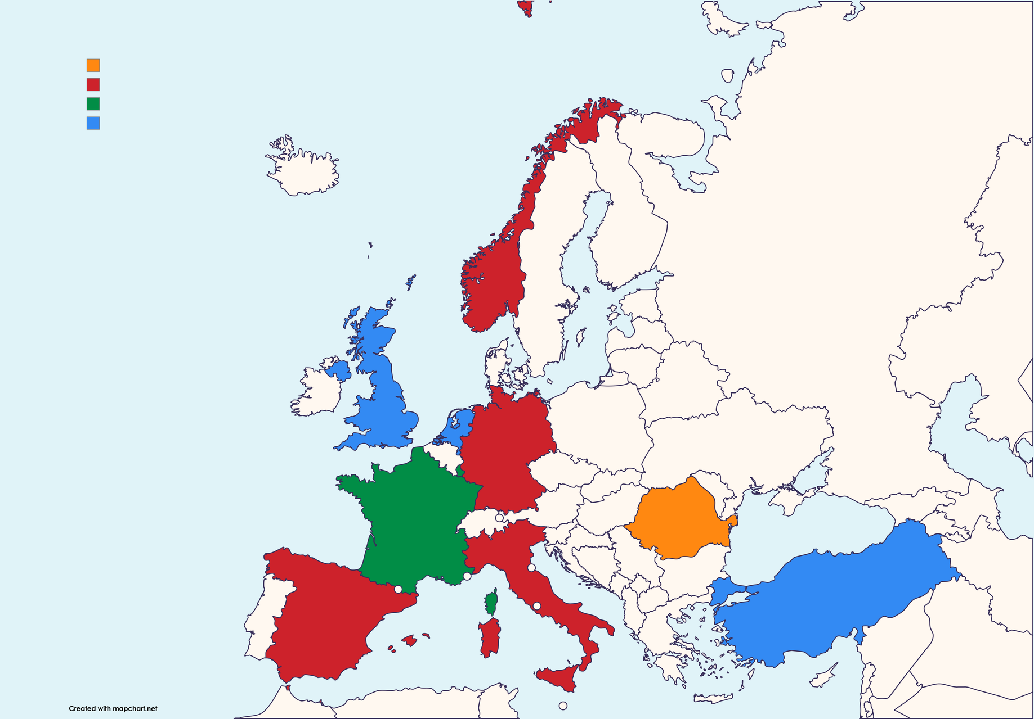










Project consortium
NANOEMCA brings together leading academic labs and specialist SMEs to cover materials design, advanced characterisation, application testing and commercialization.
National Univeristy of Science & Technology POLITEHNICA Bucharest (Coordinator)
University of Berlin
Norwegian University of Science & Technology
University of Udine
University of Zaragoza
University of Pamplona
Centre National de la Recherche Scientifique
Luxembourg Institute of Science & Technology
Aitiip Technology Center
MEDISEN R&D
Europe For Business Ltd
MGM Star Construct SRL
Kemcristal SRL
BEIA Cercetare SRL
ChiralVision B.V.
Universities
& HEIs
Research & Technology Institutes
SMEs
& Industry
Partners
SMEs & Industry Partners
Research & Tech Institutes
Coodinator Country
Universities & HEIs
NANOEMCA Project
Call: HORIZON-MSCA-SE-2024
GA No. 101235833

Slide 8
Expected outcomes
Concrete deliverables
PMO set: well-characterised nanoreactors with known properties, so others can reproduce and compare them.
Ready demonstrators: adsorbents for water cleaning, photocatalysts for pollutant breakdown, active packaging samples and gas/electrochemical biosensor prototypes for clinical or environmental use.
Open data and training materials: shared on trusted repositories so other researchers and companies can build on them.
NANOEMCA Project
Call: HORIZON-MSCA-SE-2024
GA No. 101235833

Slide 9

Expected outcomes
Concrete deliverables
Sustainability and cost reports: LCA and LCC analyses will show which synthesis and application routes have the lowest environmental footprint and the best economic prospects.
Trained people and new partnerships: Early-career researchers will gain hands-on experience through secondments, setting up new links between universities and SMEs ready for pilot projects.
NANOEMCA Project
Call: HORIZON-MSCA-SE-2024
GA No. 101235833

Slide 10

Capacity building
And mobility programs
31 early career researchers plus experienced researchers and technical staff involved in secondments
Five training modules, workshops, open days and joint supervision for PhD/postdoc students
Long-term knowledge transfer via secondments and joint IP/data frameworks
NANOEMCA Project
Call: HORIZON-MSCA-SE-2024
GA No. 101235833

Slide 11

Communication
Dissemination and engagement
Open science: data, training materials and publications on trusted repositories
Outreach: workshops, stakeholder meetings, press releases, social media and open days
Measurables: website traffic, publications, conference presentations, workshops and pilot engagements
NANOEMCA Project
Call: HORIZON-MSCA-SE-2024
GA No. 101235833

Slide 12
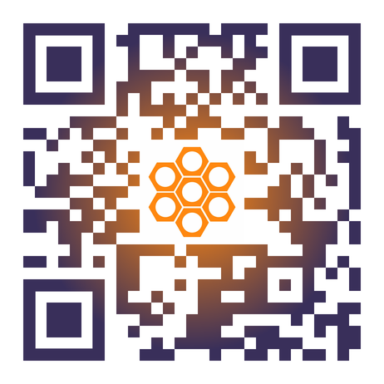
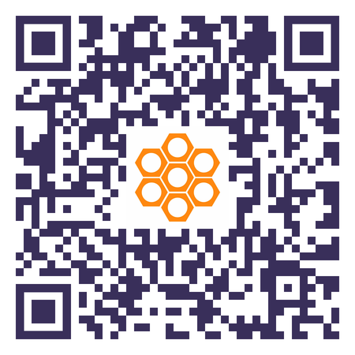





THANK YOU
For your attention
Explore our Website!
Subscribe to our Newsletter!
Presenter’s Name
✉ presenter@email.com
NANOEMCA Project EU
@nanoemcaprojecteu
NANOEMCA Project EU
NANOEMCA Project EU
@NANOEMCAProjectEU
NANOEMCA Project
Call: HORIZON-MSCA-SE-2024
GA No. 101235833

